Slide 1
Lecture 7: complex data
Trevor A. Branch
tbranch@uw.edu
Beautiful graphics in R, FISH507H
SAFS, University of Washington

Slide 2
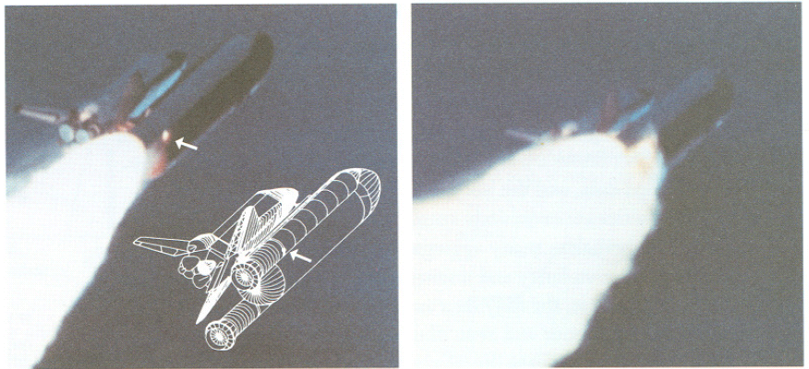
Space Shuttle Challenger
Tufte ER (1997) Visual Explanations, p. 51

Slide 3
Space Shuttle Challenger
Pre-launch recommendation not to launch at ≤ 53°F, overturned after queries from NASA
Launch temperature was 29°F
Tufte ER (1997) Visual Explanations, p. 43

Slide 4
Congressional hearing post-disaster
Tufte ER (1997) Visual Explanations, p. 49

Slide 5
Reordered by temperature
Tufte ER (1997) Visual Explanations, p. 49

Slide 6
Scatterplot
Tufte ER (1997) Visual Explanations, p. 45

Slide 7
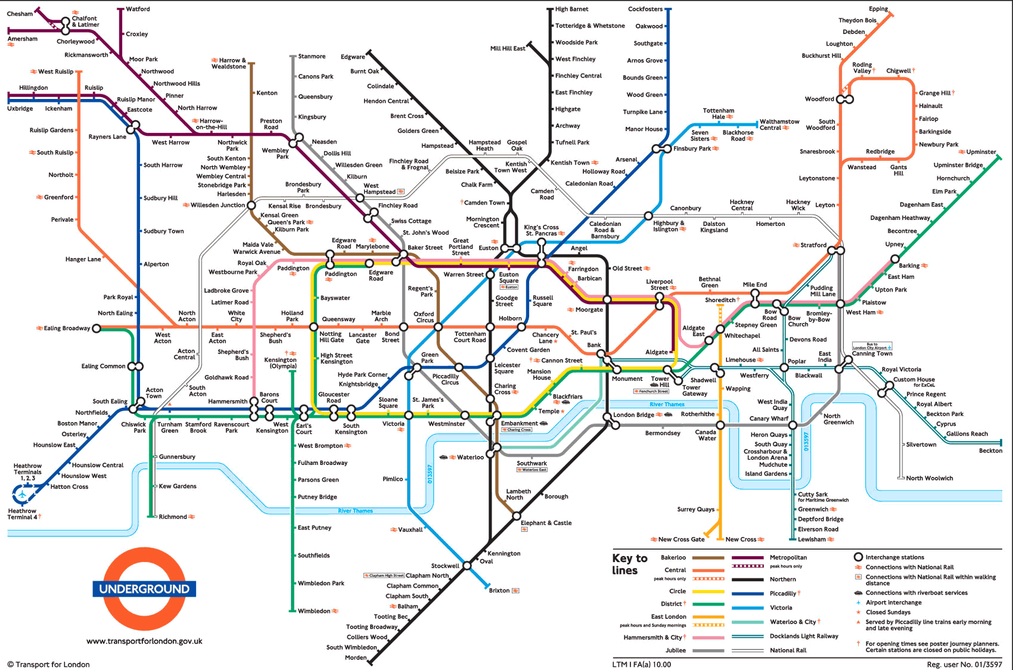
London Underground map of routes

Slide 8
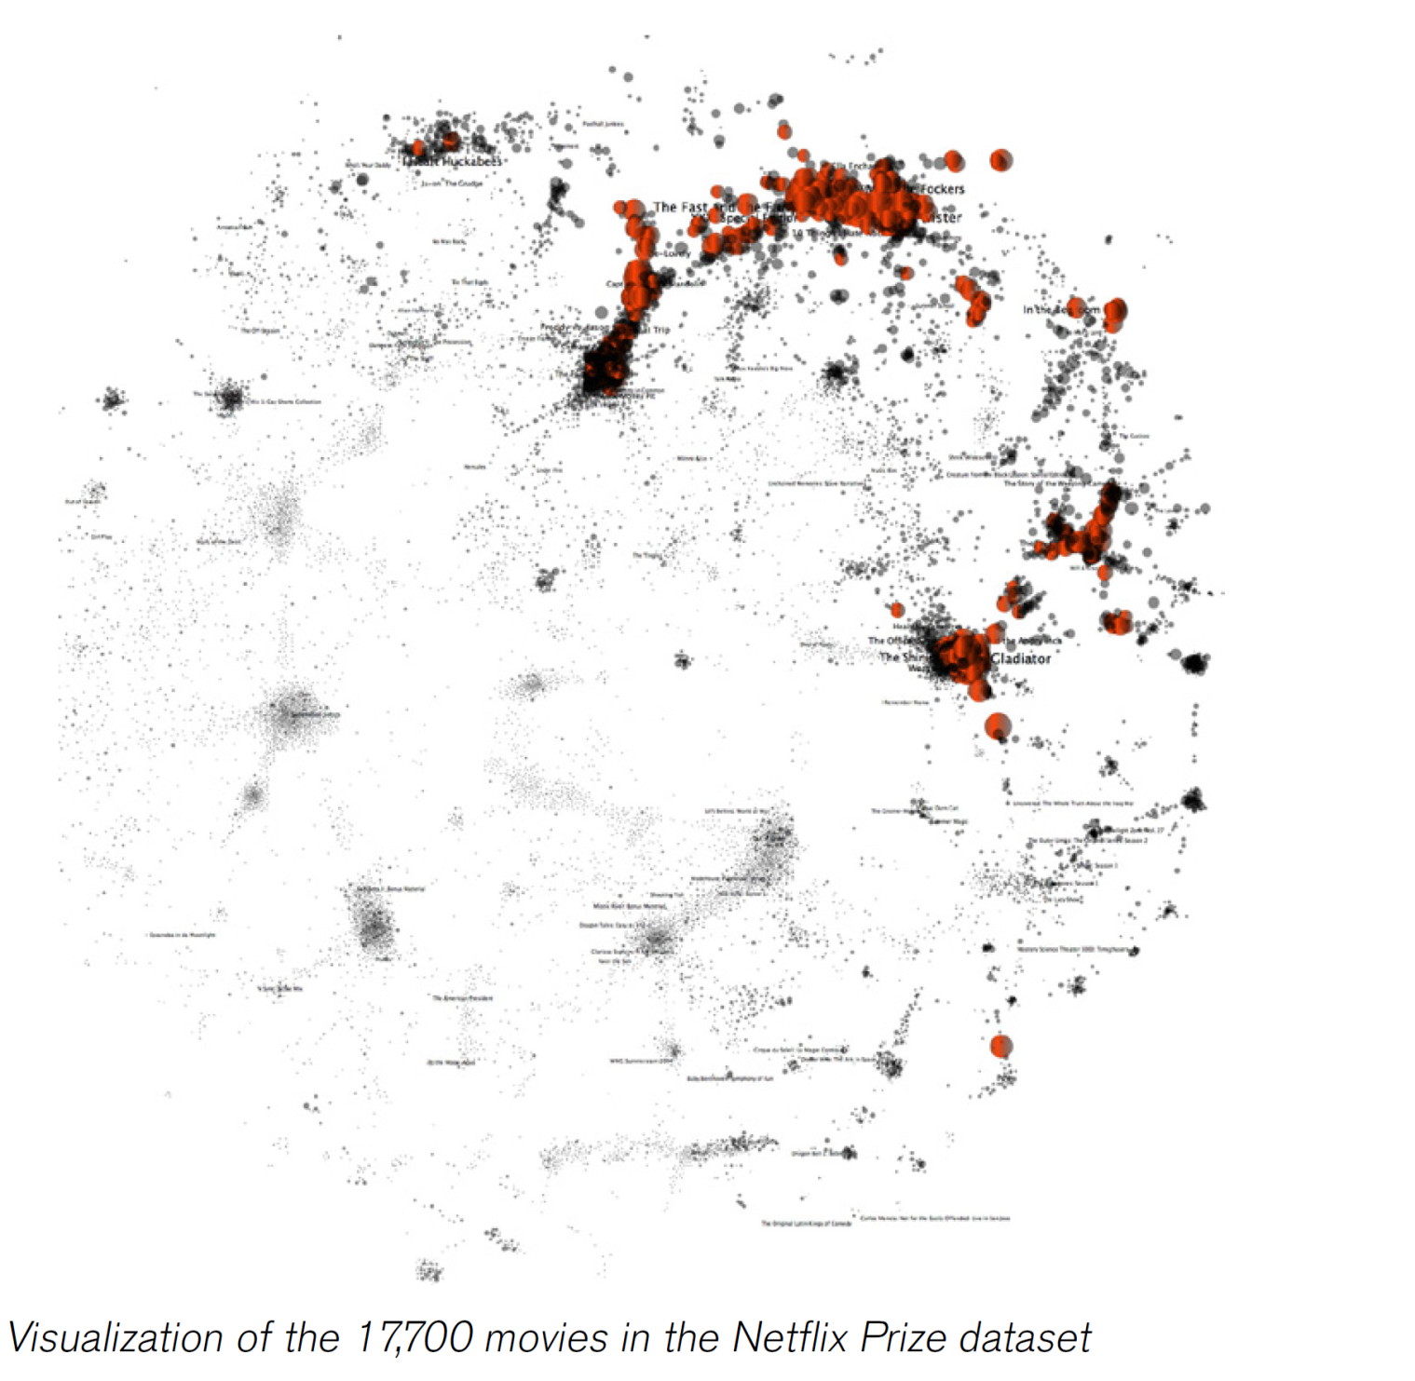
Holloway (2010) The big picture: search and discovery. pp 143-156 in Data visualization: looking at data through the eyes of experts
Notes:
I have the pdf copy of this book, not the printed version.

Slide 9
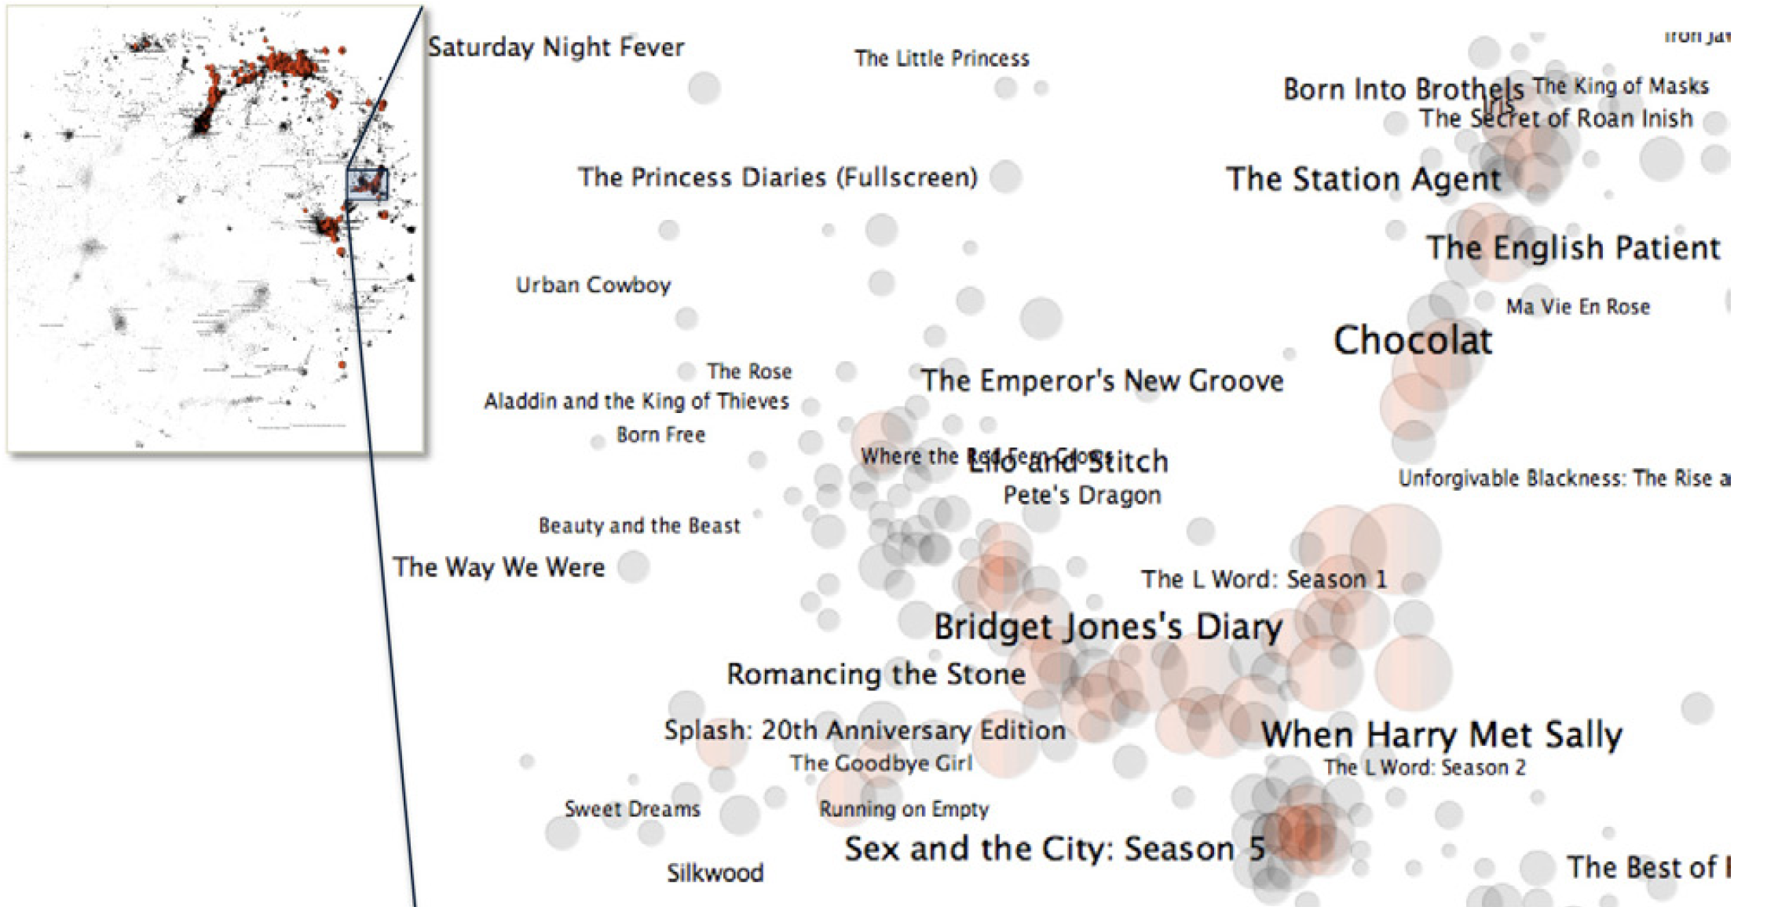
Cluster of feel-good movies
Holloway (2010) The big picture: search and discovery. pp 143-156 in Data visualization: looking at data through the eyes of experts

Slide 10
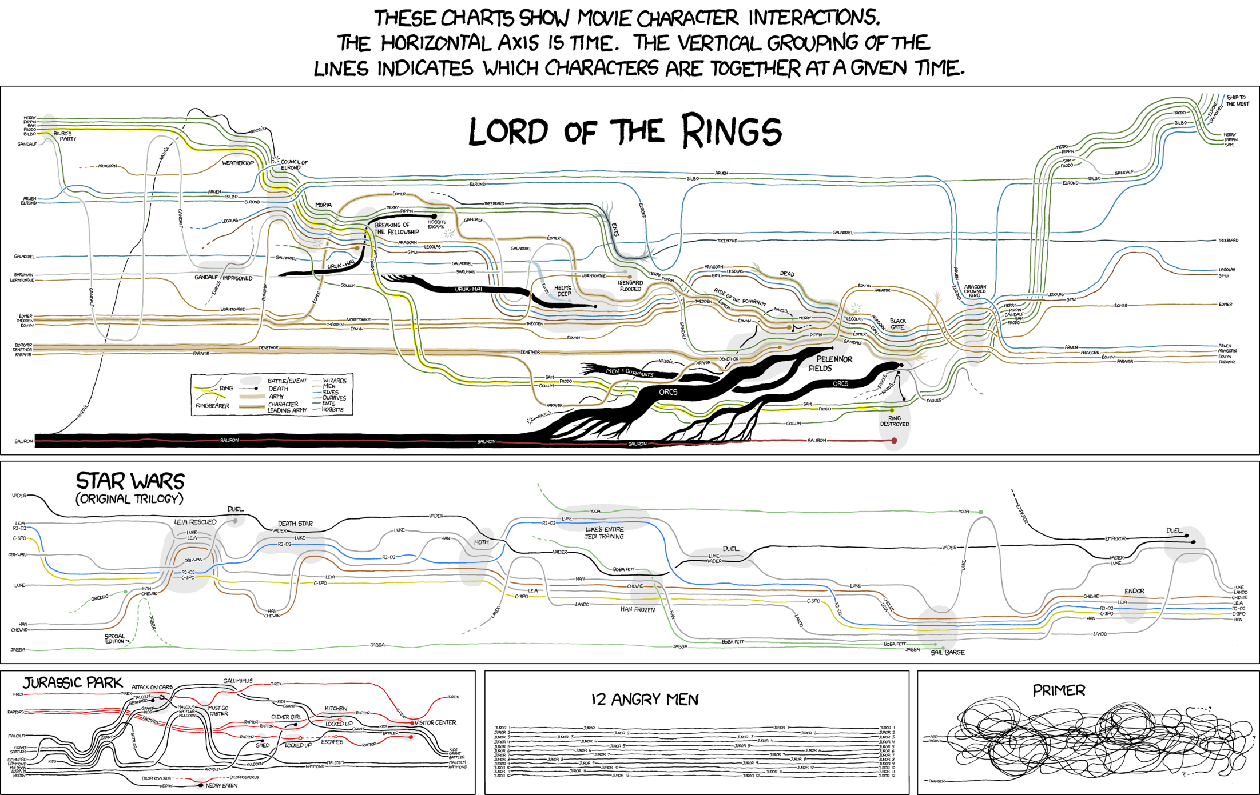
Source: http://xkcd.com/657/large/

Slide 11

Words in titles of highly cited fisheries papers
Created at: www.wordle.net
Words from https://sites.google.com/a/uw.edu/most-cited-fisheries/

Slide 12
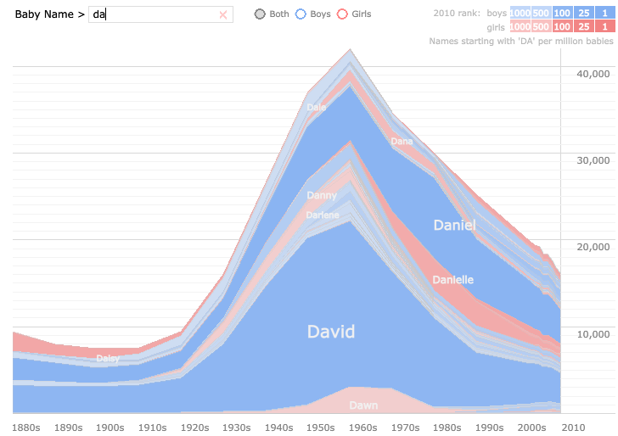
http://babynamewizard.com/voyager

Slide 13
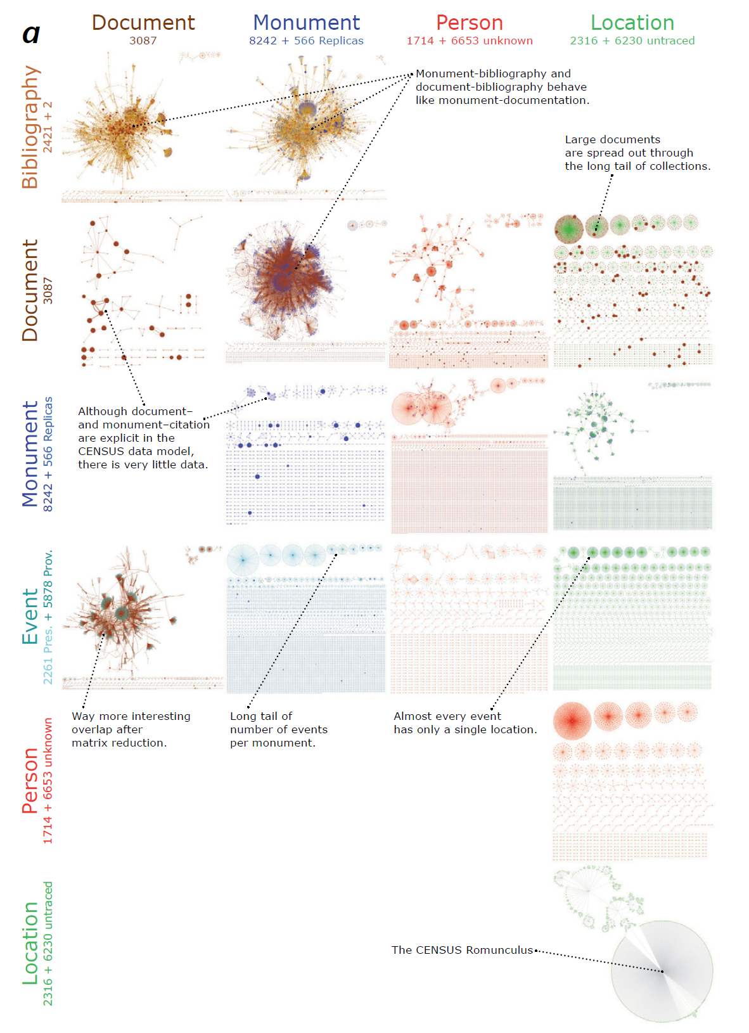
Census of antique works of art and architecture known in the Renaissance
Schich (2010) Revealing matrices. pp 227-254 in Data visualization: looking at data through the eyes of experts

Slide 14
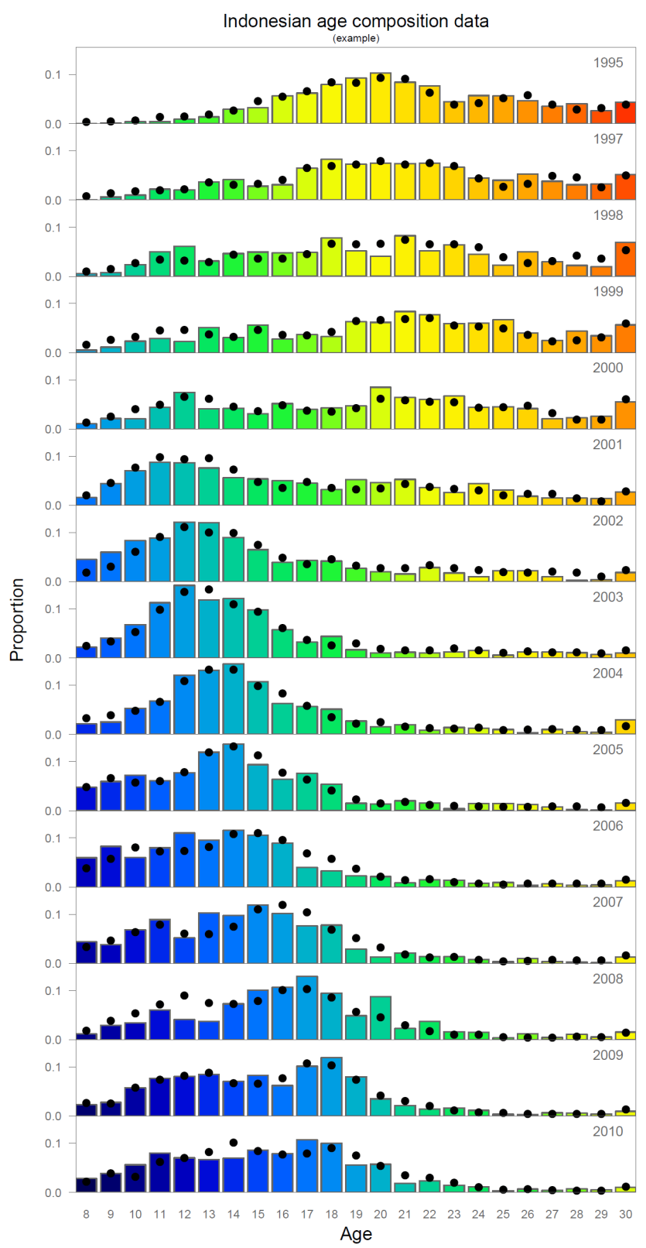
Age composition of southern bluefin tuna caught in Indonesian waters
(Colors track the cohorts of fish getting older over time)
Branch TA (2009) unpubl.

